Slide 1
Hand Dominance
This presentation will help staff:
Understand hand dominances
Know how you might notice if someone is having difficulties with developing hand dominance
Select activities to support those who are having difficulties

Slide 2
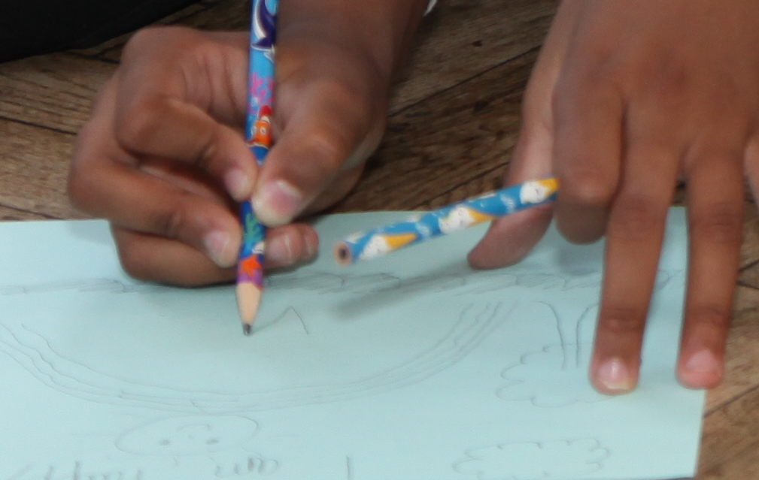
About Hand Dominance
Are you left handed? Right handed? Perhaps you are one of the few people who are ambidextrous?
As your brain developed, hand dominance established itself during the period where your gross and fine motor skills were developing and this is important as we usually have what we call a ‘working hand’ and a ‘helping hand’.
A good way to understand this is to think of cutting paper. The working hand holds the scissors and cuts; the helping hand holds, or steadies, the paper being cut.

Slide 3
About Hand Dominance
We would expect to see hand preference developing during the ages 3 – 5. However, it can be later. It is important we don’t try to force dominance to become established as it will not feel natural to the child.
This can therefore can cause delay, difficulty in performance and consequently a feeling of failure.
Children may be referred to as ambidextrous. However, true ambidexterity means being equally skilled with both hands and is rare; children with delayed hand dominance have difficulty with both hands.

Slide 4
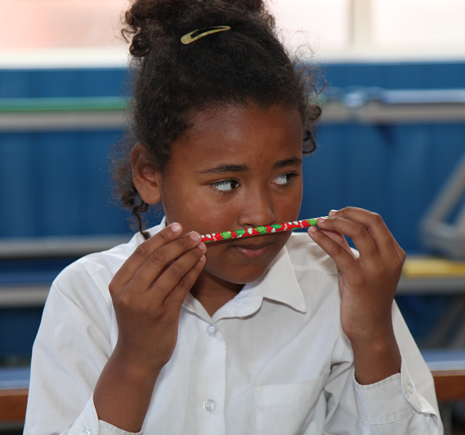
Recognising Issues With Hand Dominance
Place tools such as pencils on either the right or left – check that child reaches with one hand to pick up objects
A child with difficulty developing hand dominance will tend to reach with the left hand to pick up objects on the left and vice versa.
Swapping hands during tasks is common

Slide 5
Activities to Support
Check which hand is used most often, then place a wrist band on that frequently used hand to give a visual reminder to use the hand as the writing or working hand.

Slide 6
Activities to Support
Provide a picture of a hand to be placed on the helping hand side of any work to visually promote stabilising with the helping hand

Slide 7
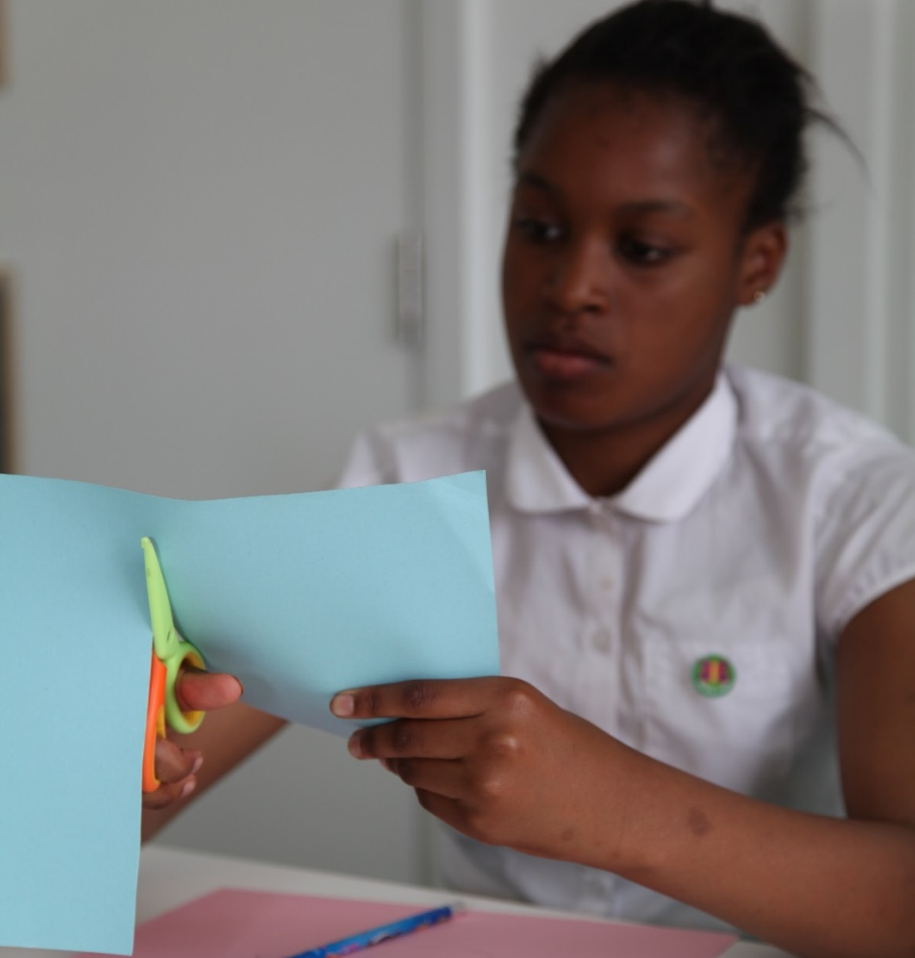
Activities to Support
Promote activities that require a stabilizing hand
E.g. opening jars, stencils, ruler use, scissor skills

Slide 8
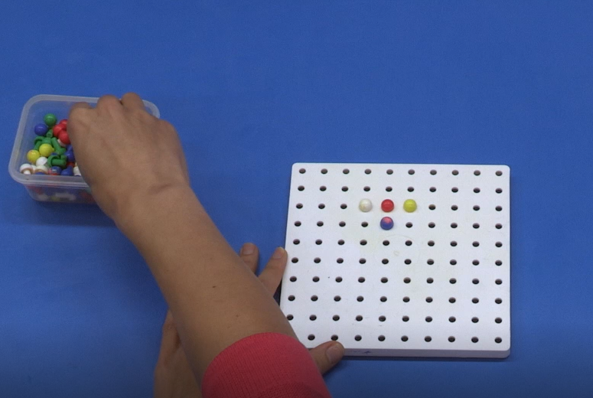
Activities to Support
Carry out midline crossing activities
e.g. drawing a large rainbow at an easel.
Midline crossing is required to enable the dominant side to reach across and is important for the task of writing.

Slide 9
Activities to Support
Reaching across the body activities promote crossing the midline.
E.g. lying on tummy and reach to pick up beanbags on the left side with the right hand and vice versa is a good activity.
This activity will give visual, proprioceptive and touch awareness while moving to complete the task and will promote bilateral skills and strength

Slide 10
Activities to Support
Whilst the child is establishing hand dominance for writing, it’s important to make sure that in all fine motor activities e.g. using scissors, cutlery, and art materials, appropriate tools are provided.
E.g. left and right handed scissors.

